Slide 1
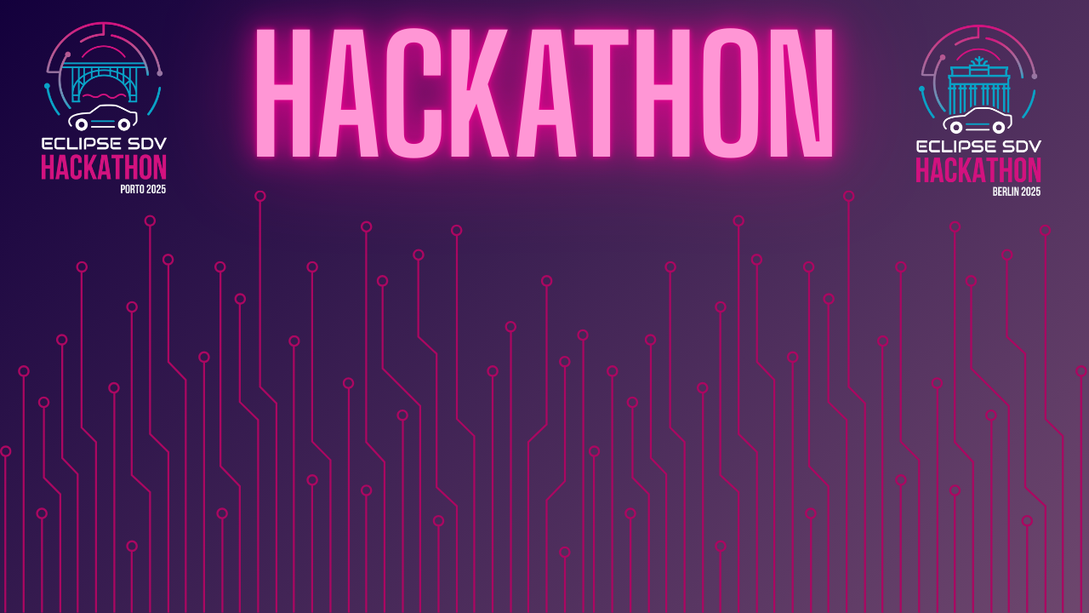

Chapter III - 2025
COPYRIGHT (C) 2025, ECLIPSE FOUNDATION

Slide 2
PITCHING SESSION Porto Motive
COPYRIGHT (C) 2025, ECLIPSE FOUNDATION

Slide 3

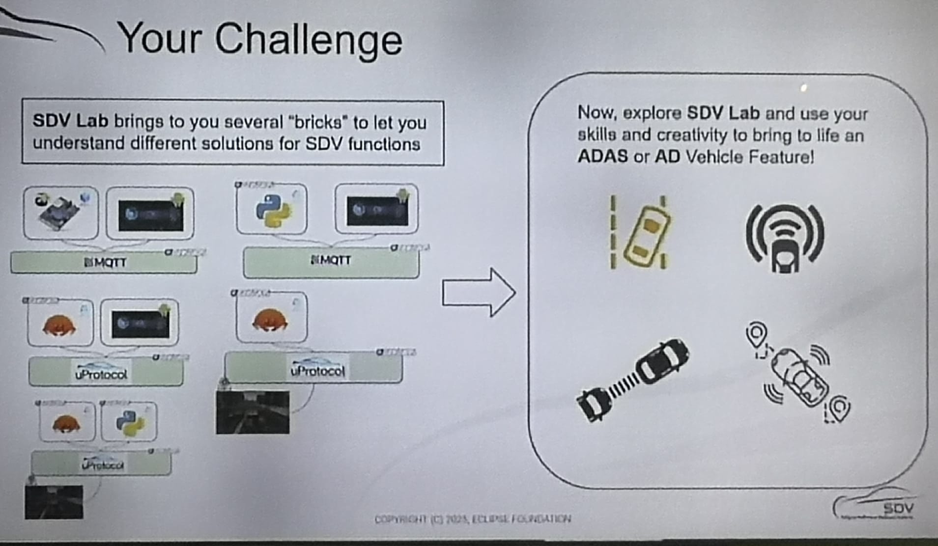
The Plan
We chose the SDV Lab.
Initial Situation At the Hackathon Eclipse SDV – Chapter Three, we were challenged to choose between two different tracks:
Software-Defined Vehicle (SDV) Lab
Mission: Update Possible
Why? Because, having no prior experience in the automotive field, it seemed:
1. more intuitive for us to start with this challenge. 2. From a learning perspective, it also felt more logical to first understand how to implement car features before moving on to the update challenge (i.e., learn first, update later).

Slide 4

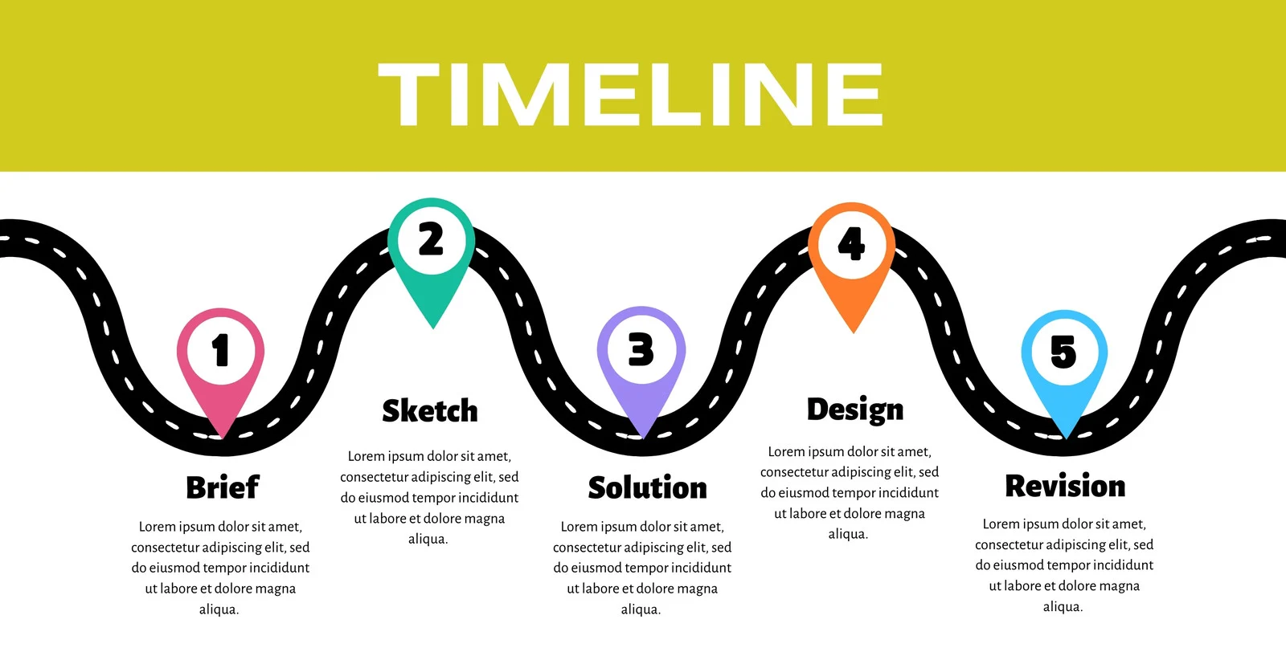
The Plan
Main Idea
Prevent rear-end collisions by enabling the first car in a traffic jam queue to deviate when a vehicle approaches at high speed (in cases where the collision would not otherwise cause a massive chain reaction).
Reduce the effects of collisions (especially in traffic jams) by redistributing the impact across the queue of vehicles — similar to Newton’s cradle — ultimately saving lives, which is our primary goal.
Plan
1. We will implement an adaptive Rear Collision Evasion System (RCES) as a proof of concept, which we name it as Backward Automotive Life-Saving System (or B.A.L.S.).
2. To achieve this, we will use CARLA (the open-source driving simulator) and design an algorithm that leverages RADAR to detect vehicles approaching from behind/rear. The system will then automatically trigger an evasive maneuver, deviating the car to the left or right (depending on available space).

Slide 5
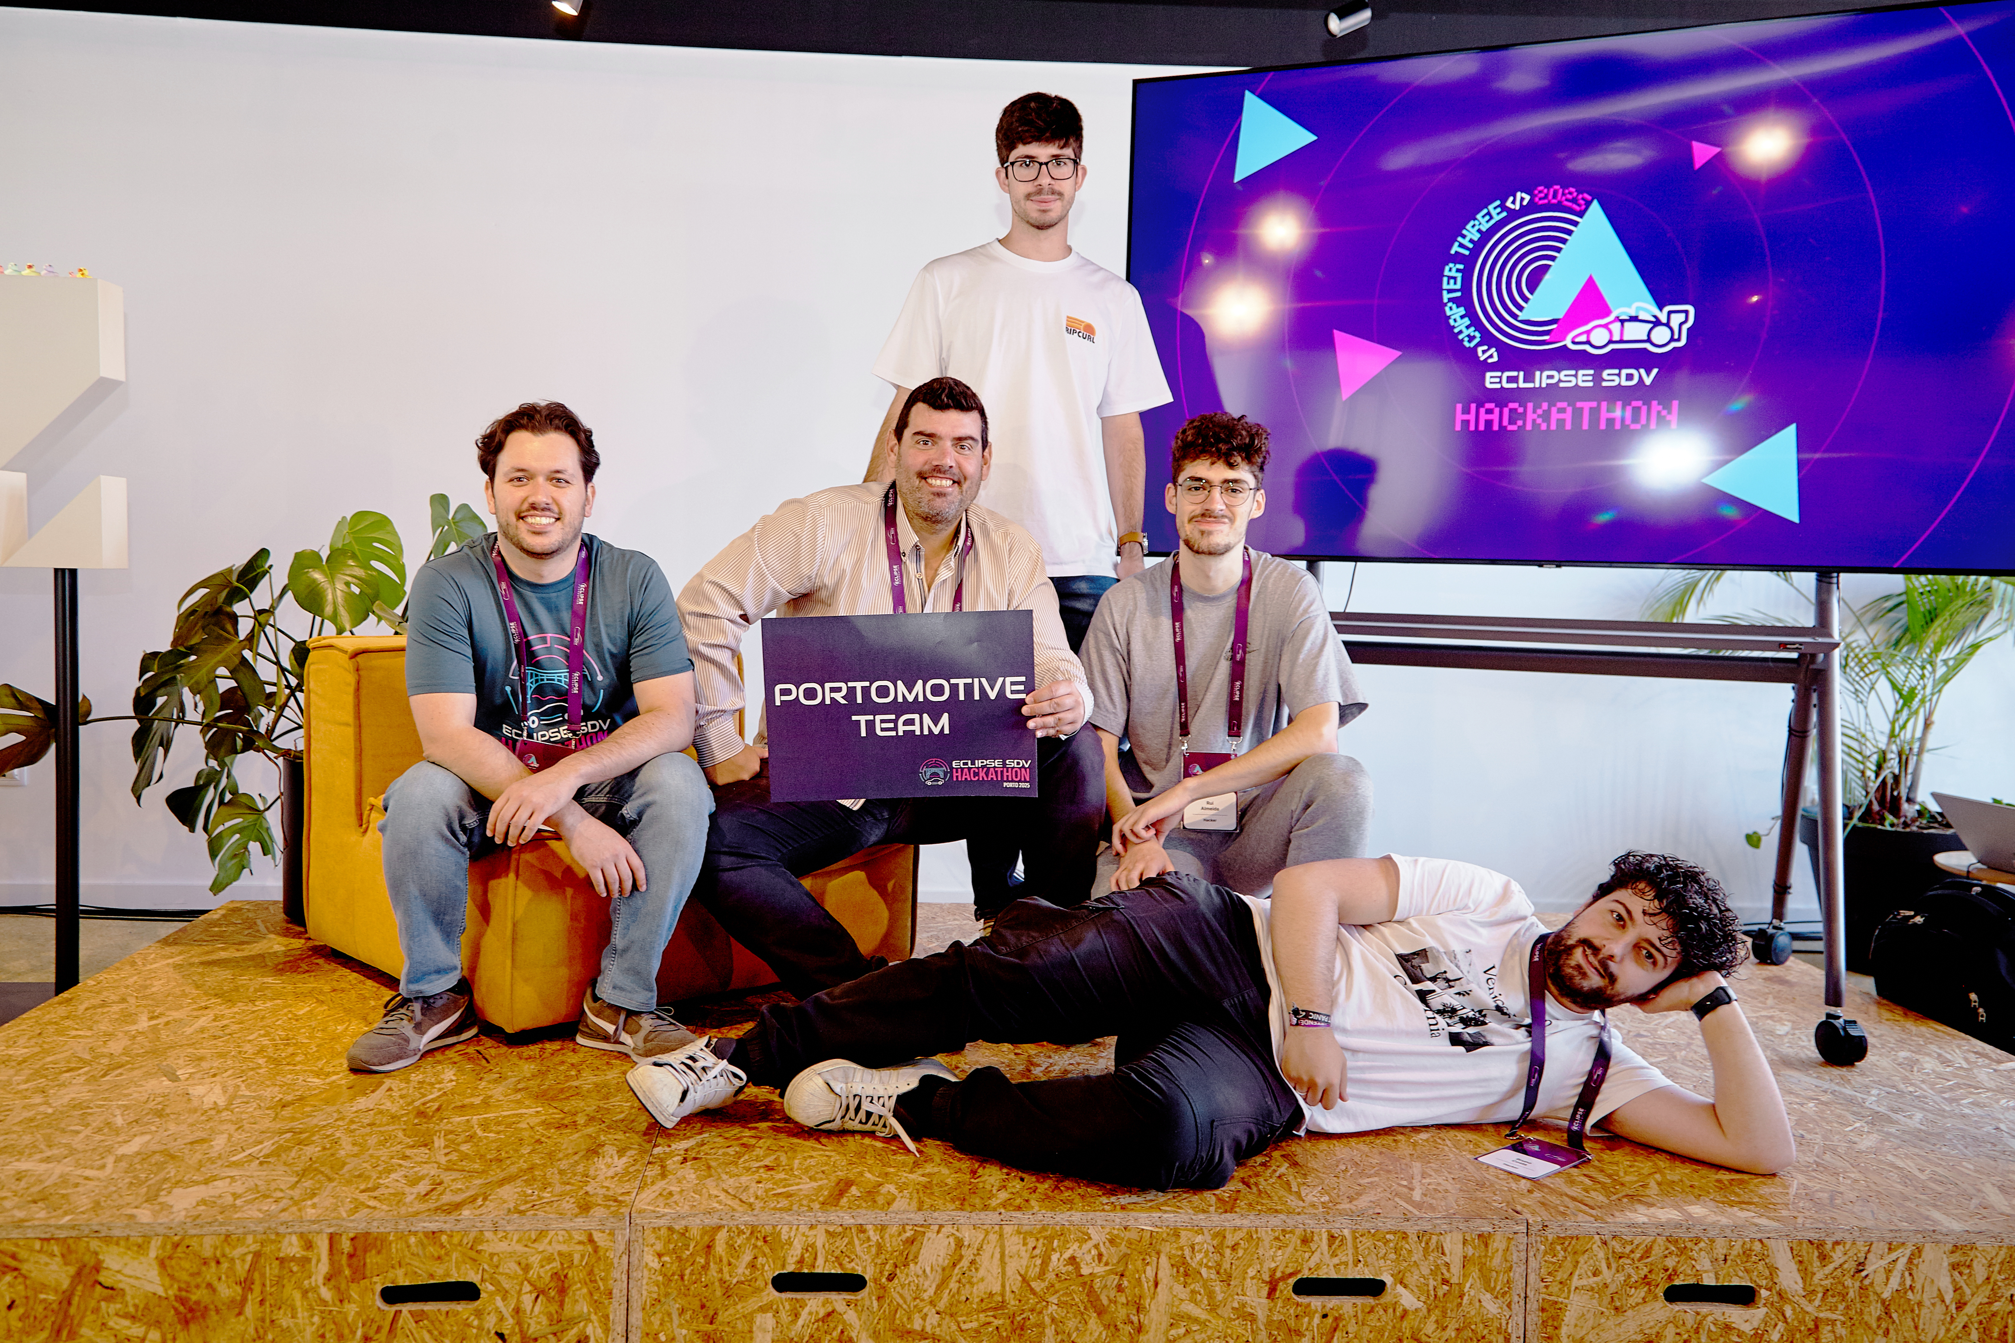
Team and Structure
Name | Role(s)
Bruno Miguel | developer
Rui Almeida | developer
Miguel Biltes | developer
João Silva | developer
Bernardo Esteves | developer

Slide 6
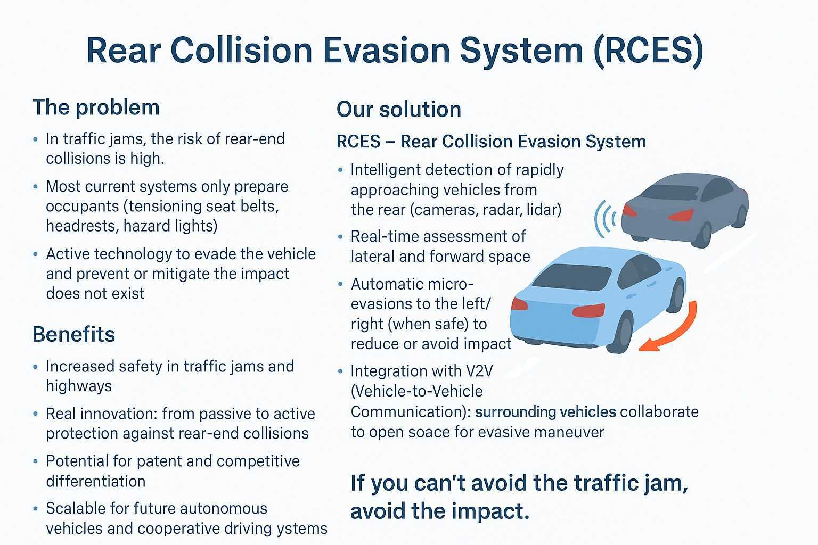
The Product / Service / Added Value
The most important goal and main purpose and improvement of this solution (namely comparing with market benchmark) is that this solution doesn´t exist…. … And effectivelly this system can save lifes.

Slide 7
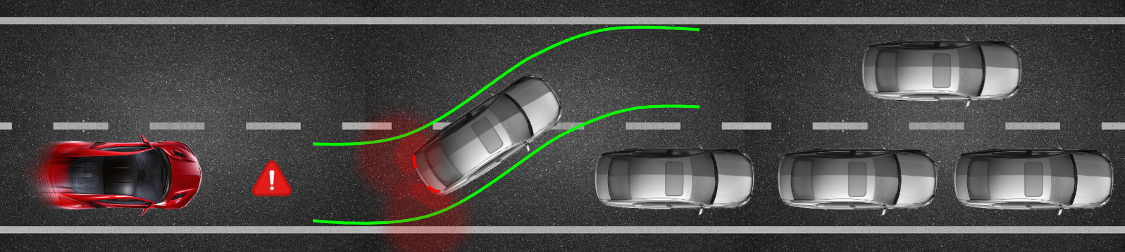
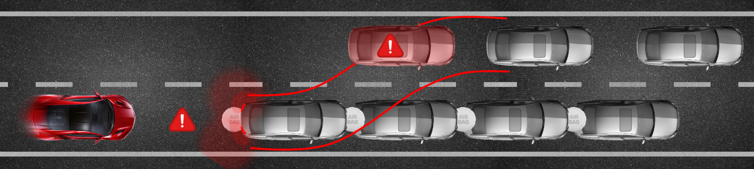

How it works - scheme
How it works
1. If there are vehicles in front of the car, the system will attempt to steer the car into an adjacent lane (either to the right or left), depending on whether the car is currently in the leftmost or rightmost lane, and only if a lane is available for the maneuver. 2. If no adjacent lane is available, the car will prepare for the collision by unlocking the brakes (of our car and the other cars) and attempting to distribute the force of the impact across all involved vehicles, minimizing the damage.

Slide 8
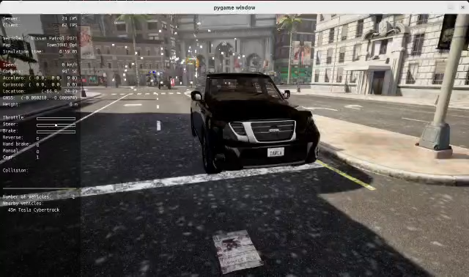

How it works – Video 1

Slide 9
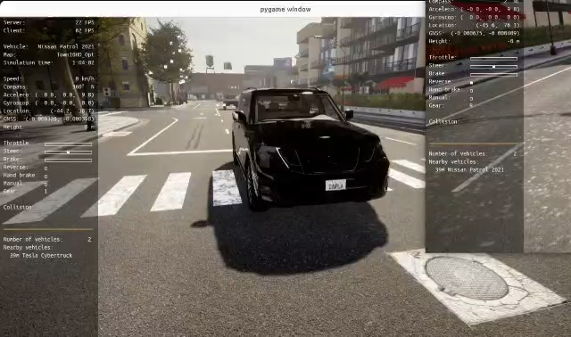
How it works – Video 2

Slide 10
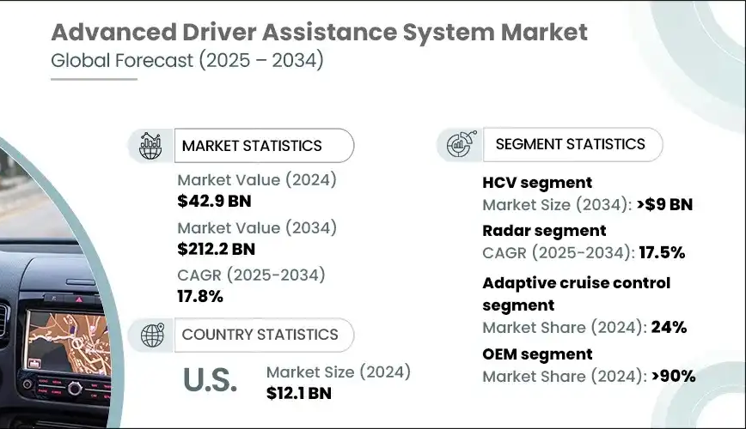
The Market & The Competition
1. Market & Market Size
Market Opportunity
Automotive Safety Systems Market (ADAS & Active Safety)
Global market size (2024): $42B+
Expected growth: CAGR ~10% until 2030
Driven by regulation (EU NCAP, NHTSA, UN ECE standards) and consumer demand for safer vehicles.
Competitors
Indirect: Current ADAS providers (Bosch, Mobileye, Continental) focus on front/side collision avoidance and emergency braking, not rear collision evasion.
Direct: None offering an active rear collision avoidance maneuvering system — this is a white space opportunity.

Slide 11
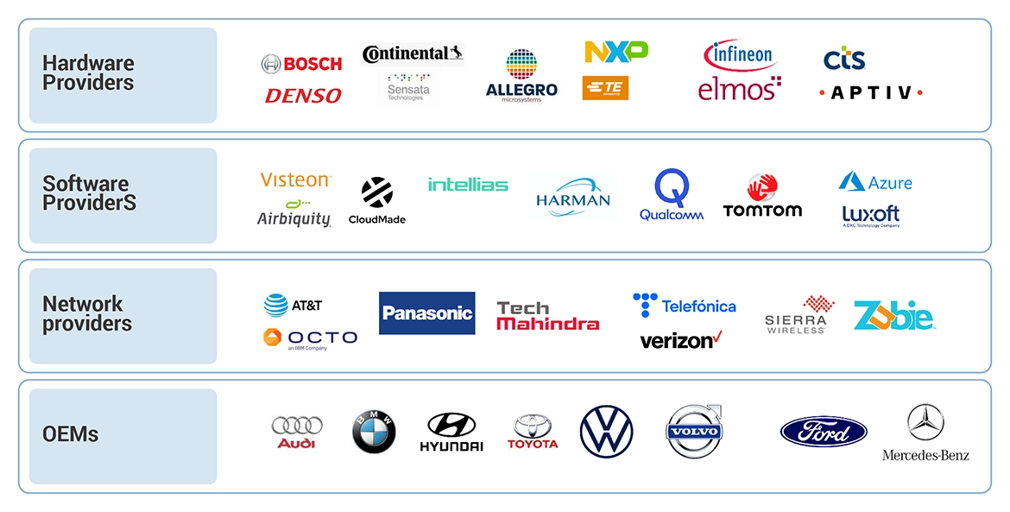
The Market & The Competition
Target Customers
OEMs (Original Equipment Manufacturers): Car makers like Mercedes, BMW, Tesla, Toyota, VW, Hyundai.
Tier 1 Suppliers: Bosch, Continental, ZF, Valeo — companies that integrate new safety tech into vehicles.
Aftermarket & Fleet Operators: Possibility of retrofitting fleet vehicles (taxis, logistics, ride-sharing).

Slide 12
The Market & The Competition
Our Differentiation:
Active evasion system → prevents or reduces the collision
B.A.L.S. integrates communication for cooperative safety
Adaptive real-time micro-maneuvers (steering & brake release to maximize force distribution) Balls make your life safier.
(Business) Opportunity
Current solutions are passive → they only prepare occupants (seatbelts, headrests, hazard lights)
Governments and insurers increasingly demand safety-first technology
Global push for road safety and autonomous driving Technologies
Increasing adoption of ADAS (Advanced Driver Assistance Systems) in all vehicle segments
Potential integration into future autonomous cars and fleet management systems

Slide 13
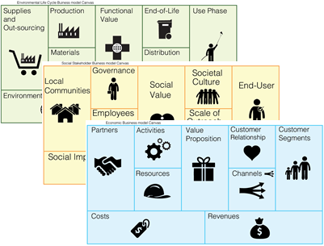
Business Model * Plan & Funds
2. Business Model
Licensing to OEMs: License RCES software + hardware integration kits to car manufacturers.
Partnerships with Tier 1 suppliers: Collaborate with Bosch, Continental, ZF, or Valeo to embed RCES into their existing ADAS platforms.
Retrofit Kits (long-term): Hardware/software retrofit for fleet vehicles (logistics, taxis, ride-hailing, buses).
Revenue Streams:
Licensing fees per vehicle
Long-term royalties (per unit sold with RCES)
Potential SaaS extension for V2V communication (subscription for fleet connectivity).

Slide 14
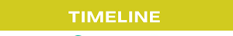
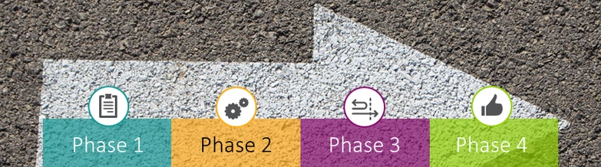
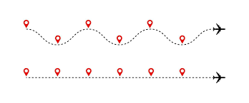
Business Model * Plan & Funds
3. Implementation Plan
Phase 1 – Concept & Prototype (0–12 months)
Simulation in CARLA + AI-based trajectory planning.
Proof-of-concept with RADAR + camera + micro-evasive maneuvering algorithms.
Phase 2 – Pilot & Testing (12–24 months)
Build partnerships with universities / automotive labs.
Test on real vehicles (retrofit kit with RADAR + ECUs).
Safety validation under EuroNCAP crash test protocols.
Phase 3 – Industrial Partnerships (24–36 months)
Collaborate with Tier 1 suppliers for system integration.
File patents on RCES algorithms and V2V integration.
Begin pilot integration with 1–2 OEMs.
Phase 4 – Commercial Rollout (36+ months)
Launch RCES as an embedded system in new vehicles.
Retrofit kits for fleets in parallel.

Slide 15



Business Model * Plan & Funds
40% – Research & Development
30% – Pilot testing & certification with partners
20% – Business development & partnerships
10% – Legal, patents & regulatory approvals
4. Investment Needs
Seed Stage (Year 1–2): ~€2–3M
R&D & Talent: Hire AI engineers, automotive software developers, safety experts.
Hardware: RADAR, LIDAR, ECUs, testing vehicles.
Simulation & Validation: CARLA infrastructure, real-world prototyping.
IP Protection: Patent filing and legal costs.
Series A (Year 2–3): ~€10–15M
Pilot Programs with OEMs and Tier 1 suppliers.
Regulatory Compliance (EuroNCAP, NHTSA validation).
Scaling R&D for V2V integration.
Series B (Year 3–5): ~€30M+
Commercial Partnerships with OEMs.
Mass production readiness.
Retrofit solutions for fleet market.

Slide 16

Business Model * Plan & Funds
Market: €40B+ growing, with a white space (no active rear collision evasion tech today).
Clients: OEMs, Tier 1 suppliers, fleets.
Business Model: Licensing + partnerships + retrofit kits.
Plan: Prototype → Pilot → Partnerships → Commercial launch.
Investment: Initial €2–3M for R&D + IP, scaling to €30M+ for commercial rollout.
Sources: - https://www.grandviewresearch.com/industry-analysis/advanced-driver-assistance-systems-adas-market - https://www.mordorintelligence.com/industry-reports/advanced-driver-assistance-systems-market?utm_ - https://www.globenewswire.com/en/news-release/2023/04/25/2653472/0/en/ADAS-Market-worth-65-1-billion-by-2030-Exclusive-Report-by-MarketsandMarkets.html?utm_ - https://www.gminsights.com/industry-analysis/adas-market/amp?utm

Slide 17

Contact
Name | GitHub
Bruno Miguel | @Bruno0798
Rui Almeida | @Rmsa42
Miguel Biltes | @Biltes
João Silva | @jpjpcs
Bernardo Esteves | @berestv

Slide 18
Thank You slide
Thank your audience and encourage them to get in touch afterwards.
COPYRIGHT (C) 2025, ECLIPSE FOUNDATION

